Slide 1
The Limits of Knowledge

Slide 2
Independent Set
Given an undirected graph G = ⟨V, E⟩ and integer k, you want to find a set of nodes S ⊆ V such that |S| ≥ k, and there are no edges with both endpoints in S.

Slide 3
Greedy?
Always choose the node with smallest degree?

Slide 4
Dynamic Programming?
Do I include the next node?
This depends on all of the previous nodes you have selected.
You will need 2^{n} subproblems to keep track of which nodes are still valid choices.
…this is a hard problem.

Slide 5
Vertex Cover
Given an undirected graph G = ⟨V, E⟩ and integer k, you want to find a set of nodes S ⊆ V such that |S| ≤ k, and all edges have an endpoint in S.

Slide 6
Greedy?
Always choose the node with highest degree?

Slide 7
I’m Cheating…
These two questions, given together, were an unfair test.
They were actually the same problem.
More specifically, IS ≤_{P} VC, and VC ≤_{P} IS.
So, if you could have solved either of these problems, you could have solved the other as well.
Take a min-sized vertex cover C.
V – C is a max-sized independent set.
Take a max-sized independent set I.
V – I is a min-sized vertex cover.

Slide 8
Set Cover
Given a set U of n elements, m subsets S₁, …, S_{m} ⊆ U, and integer k, you want to find a collection of ≤ k subsets whose union is U.
Prove that Set Cover is a hard problem, given that Independent Set and Vertex Cover are hard problems.
Do we want to show SC ≤_{P} VC?
No, that would only show that a specific solution to SC is bad: there might be a much better solution.
 | Contents
S₁ | {1,2}
S₂ | {2,3,5}
S₃ | {2,6}
S₄ | {2,4,5}
S₅ | {3,6}
S₆ | {1,5}

Slide 9

The Reduction
We want to show VC ≤_{P} SC. If we could solve SC, then we could solve VC. Since VC is hard, SC must be hard as well.
In VC, we choose nodes. In SC, we choose sets. Turn each node into a set.
In VC, we cover edges. In SC, we cover elements. Turn each edge into an element.
In VC, a node covers the incident edges. In SC, a set covers the elements in it. For each node, create a set whose members are the incident edges of that node.

Slide 10
The Class NP
Suppose you have a difficult IS instance you cannot solve.
Albert Einstein walks in, looks at it, and says “Yes! There is an Independent Set of size k,” and then he points out the correct nodes.
How long would it take you to verify his solution is a valid Independent Set of size k?
Θ(n+m): count up the nodes in the Independent Set, and verify each edge has at most one endpoint in the set.
The class NP is the set of problems with polynomial-time verifiers.

Slide 11
NP, Continued
It is much easier to verify an answer is correct than to come up with that solution on your own.
NP stands for Nondeterministic Polynomial-Time
Formally, a problem is in NP if every instance that is supposed to return “yes” has a polynomial-length “solution” or “hint” that will convince a grader the answer is “yes” in polynomial-time.
Which of the problems that we have seen are in NP?
All of them (IS, VC, SC, Sorting, Shortest Path, Array Search, etc)

Slide 12
Properties of NP
Is P ⊆ NP?
Yes. If a problem is poly-time solvable, you can simply ignore the solution/hint and solve it yourself in the given time limit.
Is P ⊊ NP?
That’s the million dollar question!
Are there problems that are definitely not in NP?
Yes: list all permutations of an input string of length n (the length of the answer is longer than polynomial, so you can’t even read it, much less verify it, in time).

Slide 13

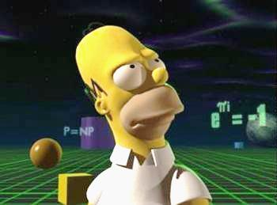
P = NP?

Slide 14
The Hardest Problem in NP
If we want to claim the million dollar prize, here is a strategy:
Identify the “hardest” problem in NP.
Either give a poly-time algorithm for it, or prove no such algorithm is possible.
It is not clear what it would even mean to be the hardest problem in NP. What kind of traits would such a problem have?
∀x∈NP, x ≤_{P} “hardest problem”
The “hardest problem” in NP is a problem called circuit-SAT.

Slide 15
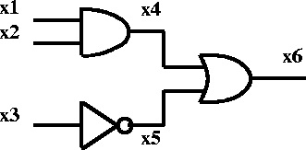
Circuit-SAT
Given a digital circuit of AND, OR, and NOT gates, is there a way to set the inputs s.t. the output will be 1?
Is circuit-SAT ∈ NP?
Yes, given the inputs, we can trace outputs through the circuit and calculate the answer in linear time.
The Cook-Levin Theorem asserts that all problems in NP are poly-time reducible to circuit-SAT.
The proof is beyond the scope of this course. If you really want to know, you can take CSCI 475 with me at some point in the future.

Slide 16
NP-Complete Problems
The Cook-Levin Theorem established Circuit-SAT as an NP-Complete problem:
Circuit-SAT ∈ NP
∀x∈NP, x ≤_{P} Circuit-SAT
If you have a new problem Z, and you show:
Z ∈ NP
Circuit-SAT ≤_{P} Z
Then what does this imply?
Z is also NP-Complete!

Slide 17
Properties of NP-Complete Problems
If you have another problem Y, and you show:
Y ∈ NP
Y ≤_{P} Circuit-SAT
What does this imply?
Nothing other than that Y ∈ NP. We already knew all problems in NP could be reduced to Circuit-SAT, and we reinvented the wheel.
This simply gives a bad solution to Y. There might be a much better one!

Slide 18


3-SAT
You are given a CNF formula with n variables x₁, …, x_{n}, and m clauses C₁, …, C_{m}, where each clause is a disjunction of exactly 3 literals.
A CNF formula is a conjunction of the clauses.
A CNF clause is a disjunction of variables and negations of variables.
$\left(\text{x}1 ˅ ¬\text{x}2 ˅ \text{x}4\right) ˄ \left(\text{x}2 ˅ \text{x}3 ˅ ¬\text{x}4\right) ˄ \left(¬\text{x}1 ˅ ¬\text{x}3 ˅ \text{x}4\right) ˄ \left(¬\text{x}1 ˅ \text{x}2 ˅ ¬\text{x}4\right)$
Setting all variables to true works here.
Is 3-SAT ∈ NP?
Walk through the clauses, evaluating if each one is true: takes linear time.
We will show Circuit-SAT ≤_{P} 3-SAT (verify this is the correct direction!)

Slide 19
A Reduction?
What do you think of this reduction?
Given a 3-SAT formula, connect the 3 literals in each clause with an OR-gate, and all the clauses with an AND-gate. Put NOT-gates in front of negated variables.
This reduction goes the wrong way. Circuit-SAT is a more generalized version of 3-SAT, and is thus the harder problem. Getting a poly-time reduction in the correct direction will be much trickier.
We are given a circuit-SAT circuit, and we need to show how to transform it into a 3-SAT formula in polynomial time!

Slide 20

A Reduction!
Add variable names to every intermediate wire in the circuit.
Hard-code the output: C₁ = (x₆)
Transform the NOT-gates: C₂ = (x₃ $˅ \text{x}\text{5}$) and C₃ = ($¬\text{x}\text{3 }˅ ¬\text{x}\text{5}$)
Transform the OR-gates: C₄ = (x₆ $˅ ¬\text{x}\text{4}$), C₅ = ($\text{x}\text{6} ˅ ¬\text{x}\text{5}$) and C₆ = ($¬\text{x}\text{6} ˅ \text{x}\text{4}$ $˅ \text{x}\text{5}$)
Transform the AND-gates: C₇ = (x₁ $˅ ¬\text{x}\text{4}$), C₈ = ($\text{x}\text{2} ˅ ¬\text{x}\text{4}$) and C₉ = ($¬\text{x}\text{1} ˅ ¬\text{x}\text{2}$ $˅ \text{x}\text{4}$)
Add repeat literals to make every clause length-three: C₁ = (x₆ $˅$ x₆ $˅$ x₆)
This was only an example! The above reduction works regardless of the input circuit!

Slide 21
Independent Set
$$¬\text{x}\text{1}$$
$$¬\text{x}\text{2}$$
$$¬\text{x}\text{3}$$
$$\text{x}\text{2}$$
$$\text{x}\text{3}$$
$$\text{x}\text{1}$$
$$\text{x}\text{3}$$
$$\text{x}\text{2}$$
$$\text{x}\text{1}$$
3-SAT ≤_{P} IS:
You are given a 3-SAT instance such as $\left(¬\text{x}1 ˅ \text{x}2 ˅ \text{x}3\right) ˄ \left(\text{x}1 ˅ ¬\text{x}2 ˅ \text{x}3\right) ˄ \left(\text{x}1 ˅ \text{x}2 ˅ ¬\text{x}3\right)$
Add 3 nodes in a triangle for each clause.
Add edges between inconsistent variable assignments.
Find an IS of size m, which is the variable to satisfy each clause.
That means we have 5 NP-Complete problems now!

Slide 22
Set Packing
Given a set U of n elements, m subsets S₁, …, S_{m} ⊆ U, and an integer k. You want to find a collection of k subsets which have no overlap.
IS ≤_{P} SP:
In IS we choose nodes, and in SP we choose subsets. Each node becomes a subset.
In IS we conflict if there is an edge in common, and in SP we conflict if there is an element in common. Each edge becomes an element.
In IS, a node conflicts with the edges incident to it, and in SP, a subset conflicts with the elements in it. So, each node becomes a set containing the edges incident to it.
 | Contents
S₁ | {1,2}
S₂ | {2,3,5}
S₃ | {2,6}
S₄ | {2,4,5}
S₅ | {3,6}
S₆ | {1,5}

Slide 23





K-Clique
Given an undirected graph G and integer k, is there a set S of k nodes such that there is an edge between every pair of nodes in S?
K-Clique is in NP: given a clique, verify every pair of edges exists in O(m) time.
IS ≤_{P} k-Clique:
Create G’ = ⟨V,E’⟩, where ⟨u,v⟩∈E’ iff ⟨u,v⟩∉E
Find a clique of size k.
These nodes form an independent set on G.
$$¬\text{x}\text{2}$$
$$\text{x}\text{3}$$
$$\text{x}\text{1}$$
$$\text{x}\text{3}$$
$$\text{x}\text{2}$$

Slide 24
Does P = NP?
There are a lot of NP-Complete problems. That’s why we’re pretty sure P ≠ NP
To prove P = NP, all we need to do is find a poly-time solution for any one of these problems.
Given how much effort we’ve put into this, we would have expected to solve the problem by now if P = NP.
Showing a problem doesn’t have a polytime solution is much harder, so we think that this reflects reality.

Slide 25
Directed Hamiltonian Cycle
Given a directed graph G, find a cycle that visits every node.
Given a cycle, check off each node to ensure you visit every node exactly once and end where you started, and verify there is an edge between each adjacent pair of nodes in the cycle. This can be done in linear time, so DHC ∈ NP
We will show 3-SAT ≤_{P} DHC
We will make a bi-directional chain of nodes for each variable. You can traverse the chain either left-to-right, or right-to-left, corresponding to whether that variable is true or false.
We will add clause nodes that can only be visited if you are traversing the chain of nodes in the correct direction.

Slide 26
The Reduction
$$\left(x1 ˅ x2 ˅ ¬x3\right) ˄ (¬x1 ˅ x2 ˅ x3)$$
$x1$ left-to-right →
← right-to-left $¬x1$
Clause 1
Clause 2
$x2$ left-to-right →
← right-to-left $¬x2$
$x3$ left-to-right →
← right-to-left $¬x3$

Slide 27
Undirected Hamiltonian Cycle
Given an undirected graph G, is there a cycle that visits every node?
In NP for the same reason as DHC.
We will show DHC ≤_{P} UHC
This problem is potentially easier than DHC, as any undirected graph can be represented as a directed graph.
a
a
d
d
v
v_{in}
v
v_{out}
b
e
b
e
c
f
c
f

Slide 28

Directed Longest Path & Directed Hamiltonian Path
Given a directed graph G and integer k, is there a path in G of length ≥ k?
Directed Longest Path is in NP, because given a path you can check off the nodes to ensure there are no repeats, and you can verify that every required edge exists, all in linear time.
We will show DHC ≤_{P} DLP

Slide 29
The Reduction
Add a node s, connected to an arbitrary node u.
Add a node t, connected from all nodes with an edge to u.
Find a path of length n+2, or a Hamiltonian Path, on the new graph.
This reduction takes linear time.
This reduction works for both Directed Longest Path, and Directed Hamiltonian Path.
s
t

Slide 30
Undirected Longest Path & Undirected Hamiltonian Path
Given an undirected graph G and integer k, is there a path in G of length ≥ k?
Undirected Longest Path is in NP, because given a path you can check off the nodes to ensure there are no repeats, and you can verify that every required edge exists, all in linear time.
We will show UHC ≤_{P} ULP

Slide 31
The Reduction
Add a node s with an edge to an arbitrary node u
Add a node v with edges from all nodes that have edges to u.
Add a node t with an edge to v.
Find a path of length n+3, or a Hamiltonian Path, on the new graph.
This reduction takes linear time.
This reduction works for both Undirected Longest Path, and Undirected Hamiltonian Path.
s
t
v

Slide 32
Travelling Salesperson Problem
Given a set of n cities, where the distance between cities u and v is specified by d(u,v) which satisfies triangle inequality, and a value D, find a tour of length ≤ D.
TSP ∈ NP: Check off cities when visited to ensure everything is covered, and sum up the total distance traveled to ensure it is bounded by D. Takes linear time.
UHC ≤_{P} TSP
Add edge weight 1 to all existing edges.
Add all missing edges with weight 2.
Find a tour with D=n.
Ensures that we never use the missing edges, while also maintaining triangle inequality.

Slide 33
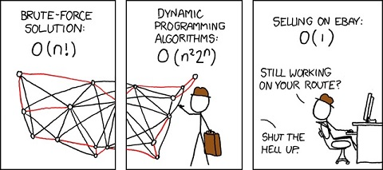
XKCD #399

Slide 34
Subset Sum
In the Subset Sum problem, you are given a set of integers w₁, …, w_{n} and an integer W, and you want to determine if there is a subset of the integers that add up exactly to W.
Subset Sum is in NP, because you can add up the provided integers in linear time to determine if they equal the target.
We will show 3-SAT ≤_{P} SS

Slide 35
The Reduction
As an example, consider: (x₁ ˅ ¬x₂ ˅ ¬x₃) ˄ (¬x₁ ˅ ¬x₂ ˅ ¬x₃) ˄ (¬x₁ ˅ ¬x₂ ˅ x₃) ˄ (x₁ ˅ x₂ ˅ x₃)
 | x₁ | x₂ | x₃
w₁ | 1 | 0 | 0
¬w₁ | 1 | 0 | 0
w₂ | 0 | 1 | 0
¬w₂ | 0 | 1 | 0
w₃ | 0 | 0 | 1
¬w₃ | 0 | 0 | 1
W | 1 | 1 | 1
C₁ | C₂ | C₃ | C₄
1 | 0 | 0 | 1
0 | 1 | 1 | 0
0 | 0 | 0 | 1
1 | 1 | 1 | 0
0 | 0 | 1 | 1
1 | 1 | 0 | 0
4 | 4 | 4 | 4
 | x₁ | x₂ | x₃ | C₁ | C₂ | C₃ | C₄
d₁ | 0 | 0 | 0 | 1 | 0 | 0 | 0
d₁’ | 0 | 0 | 0 | 2 | 0 | 0 | 0
d₂ | 0 | 0 | 0 | 0 | 1 | 0 | 0
d₂’ | 0 | 0 | 0 | 0 | 2 | 0 | 0
d₃ | 0 | 0 | 0 | 0 | 0 | 1 | 0
d₃’ | 0 | 0 | 0 | 0 | 0 | 2 | 0
d₄ | 0 | 0 | 0 | 0 | 0 | 0 | 1
d₄’ | 0 | 0 | 0 | 0 | 0 | 0 | 2

Slide 36
How do you recognize an NP-Complete Problem?
There are no shortcuts: you have to find the reduction or the algorithm to know for sure.
Longest Path is NP-Complete
Longest Path on a DAG is easy!
3-SAT is NP-Complete
2-SAT is easy!
Independent Set is NP-Complete
Independent Set on a tree is easy!

Slide 37
3-Color
Given an undirected graph G, you want color each node one of 3 colors Cardinal, Gold, and Blue, so that no edge has the same color on both endpoints.
3-Color is in NP, because given a coloring, you can iterate over the edges and verify they don’t have the same color on their endpoints. This takes linear time.
We will show 3-SAT ≤_{P} 3-Color

Slide 38
The Reduction
Create 3 nodes in a triangle: the True node, the False node, and the Base node.
Create two nodes for each variable, connected to each other, and to the base node.
Create 6 nodes for each clause, connected to each other, the true node, the false node, and the three literals in that clause, in the manner specified by the diagram.
x₂
¬x₂
x₁
x₃
¬x₁
B
¬x₃
T
F
x₁
x₃
F
¬x₂
T

Slide 39
k-Color
Given an undirected graph G, you want color each node one of k colors, so that no edge has the same color on both endpoints.
k-Color is in NP, because given a coloring, you can iterate over the edges and verify they don’t have the same color on their endpoints. This takes linear time.
We will show that k-Color ≤_{P} (k+1)-Color

Slide 40
The Reduction
Create a new node, with an edge to all existing nodes.
The new node must be a different color than all other nodes, so this will require exactly one more color than the original instance.

Slide 41
3-D Matching
Given n instructors, n courses, n times, and a list 3-tuples indicating valid pairings of courses, times, and instructors, find an assignment where all instructors teach one class, all courses are taught by one instructor, and every timeslot is utilized by one class.
Instructor | Aaron | Aaron | Aaron | Brendan | Brendan | Xing | Xing | Xing
Course | 170 | 170 | 270 | 104 | 170 | 104 | 170 | 270
Time | 1pm | 11am | 11am | 1pm | 11am | 3pm | 3pm | 1pm

Slide 42
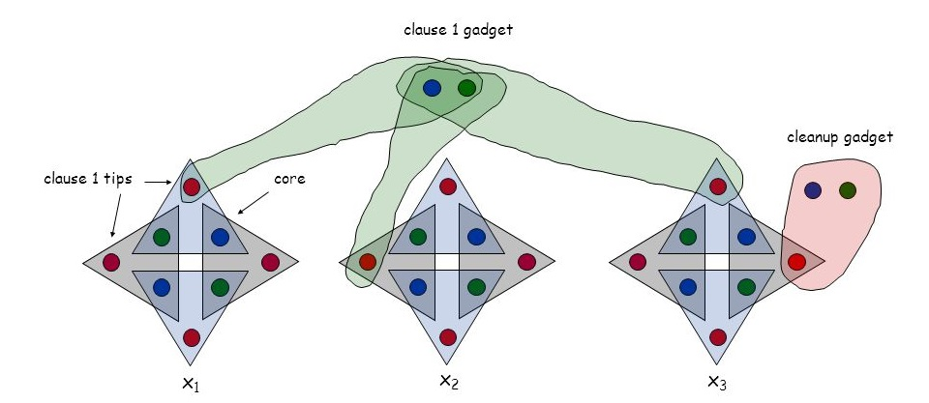
The Reduction

Slide 43
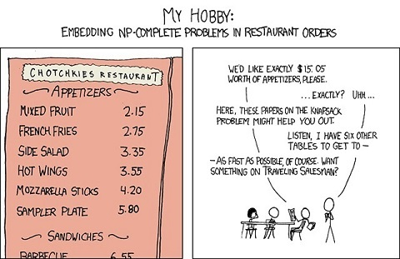
XKCD #287: NP-Complete
General solutions get you a 50% tip.

Slide 44
Extra Practice
Chapter 28
Exercises 5, 6, 7, 8, 12, 14, 17, 26, 28, 29, 36

